Slide 1
What are your key principles for effective teaching to make sure pupils make excellent progress and have a high retention rate?

Slide 2
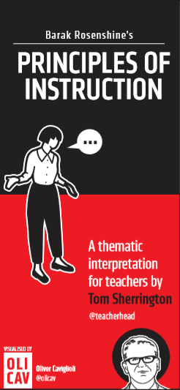
It resonates for teachers of all subjects and contexts – because it focuses on aspects of teaching that are pretty much universal: questioning, practice, building knowledge.
It links practice to cognitive psychology, supporting the formation of a sound theory of action –providing a link between teachers’ actions and the learning process. There are multiple explanatory references to ideas about memory and cognitive load theory. For each practical strategy, there is an underpinning model based in evidence.
There are four very clear strands that run through the 10 sections – reviewing material, questioning, explaining and modelling, practice. Each of one these can be a focus area for improvement so there are multiple ways to engage with the ideas and to find a focus for deliberate practice.

Slide 3
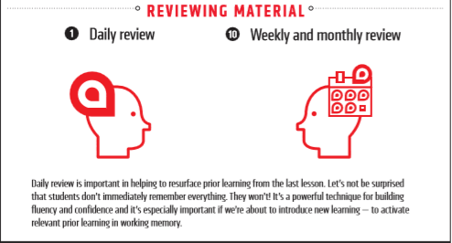

Slide 4
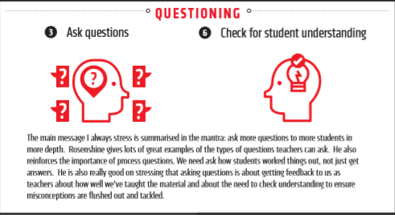

Slide 5

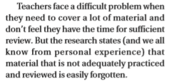

Slide 6
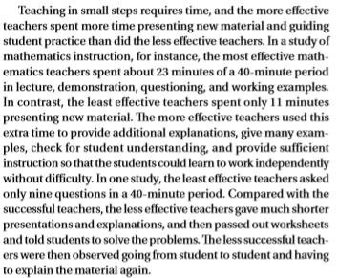

Slide 7
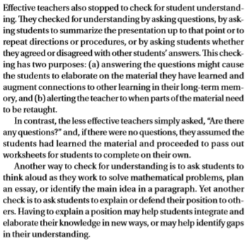

Slide 8
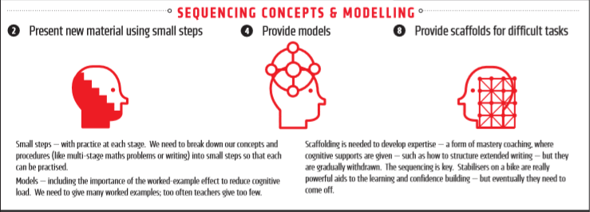

Slide 9

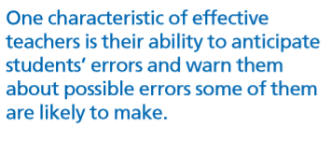

Slide 10
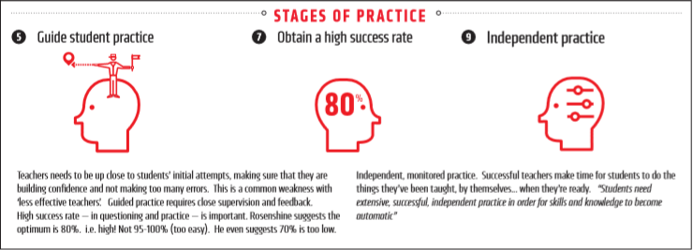

Slide 11

If a schema contains incorrect information - a misconception or an incomplete model of how a process works – we can’t simply overwrite it.

Slide 12
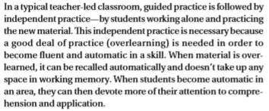

Slide 13
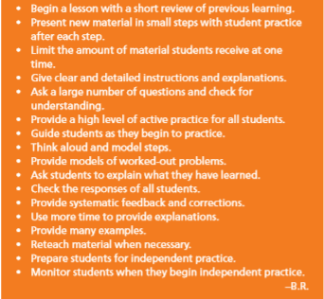

Slide 14
Rosenshine’s principles of instruction as a pdf: https://www.aft.org/sites/default/files/periodicals/Rosenshine.pdf Geography example: https://heathfieldteachshare.wordpress.com/2018/04/23/putting-theory-into-practice/ Article on applying the science of learning in the classroom: https://impact.chartered.college/article/howard-jones-applying-science-learning-classroom/

