Slide 1
Cognitive load theory
1st September 2020

Slide 2
Quick Overview
What is CLT?
What is intrinsic load?
What is extraneous load?

Slide 3
What Is cognitive load theory?
CLT is a theoretical model that seeks to explain how learning takes place and which methods of teaching will be most effective as a result.
Our working memory is extremely limited.
Our long-term memory is essentially limitless; we can store information and retrieve it when needed, thereby freeing up space in our working memory.
The theory suggests that we consider the “load” placed on working memory by a task pupils have been given. This load comprises of two parts.

Slide 4
Quiz…
What are the two types of load?
What is Schema?
What are the three types of memory core to CLT?

Slide 5
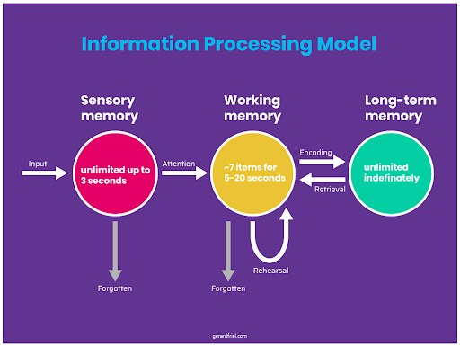

Slide 6
Intrinsic & Extraneous load
The intrinsic load is created by the complexity of the task itself.
The more difficult the task, or the more novel the information the higher the load.
We want to manage the intrinsic load but not necessarily reduce it. We want our pupils to tackle difficult tasks as it makes them think hard .
The second kind of load we want to consider is the extraneous load. These are pressures put on the working memory by things outside the material being learned.
They might come from overly complex instructions, distractions in our environment or being given too much additional information.

Slide 7
Discussion
How do we control our intrinsic and extraneous load?
What level of intrinsic load do we want?
Is this the same for everyone?
How can we change this?

Slide 8
Reading
https://www.tes.com/news/how-useful-cognitive-load-theory-teachers

