Slide 1
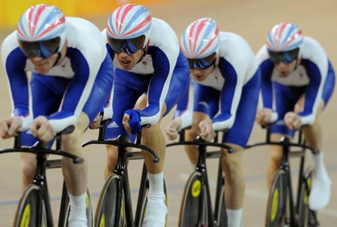
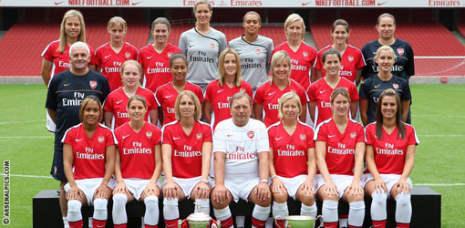
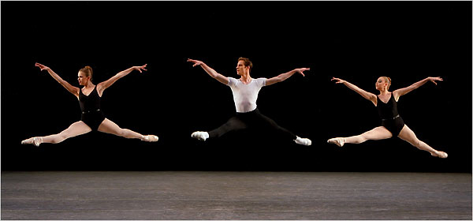
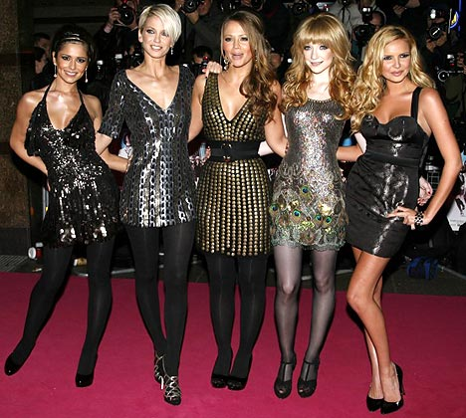
What do they have in common?
Notes:
Task: 2 minutes in pairs to discuss what do all these have in common?
The answer is that they are all highly effective teams.
British Olympic cycling team. - Won 8 gold medals at Beijing Olympics led by performance director Dave Brailsford.
Arsenal women's team - In 22 years, up until the 2008/9 season Arsenal Women’s Team won
33 major trophies including 1 Women’s UEFA Cup, 3 domestic Trebles, 12 Premier League Titles, 10 National League Cups and 10 FA Cups, further cementing the Ladies team really are the present dominant force in the English domestic game. They won their 7th successive Premier League title this year…
Girls aloud : Sold 10 million records worldwide
Most consecutive top ten entries by a female group
All album have gone platinum.
Must successful reality tv group
The New York city ballet: The New York City Ballet, one of the foremost dance companies in the world, is unique in US artistic history. Solely responsible for training its own artists and creating its own works, the New York City Ballet was the first ballet institution in the world with two permanent homes, the David H. Koch Theater at Lincoln Center and the Saratoga Performing Arts Center in Saratoga Springs, New York

Slide 2
Effective Middle Leadership Session 1 – Building a Team
Area of focus:
Building Teams
Key questions/lines of enquiry:
How can we develop an effective team and what barriers might we face?
Desired outcomes:
-identify common features of a great team
-gain practical wats in which to build a team

Slide 3

What made the difference?
Attention to detail
Results focused
Shared vision
Total trust in each other
High morale
Notes:
So what can we learn from them? Let’s have a look at one of them a little closer. The British cycling team.
Task: 2 minute discussion, what was it about this team that made them so successful?
The list of the left is not exhaustive, but it includes some of the reasons. Leadership of course may well be mentioned. So let’s have a look at their leader and what he has to say about it.

Slide 4
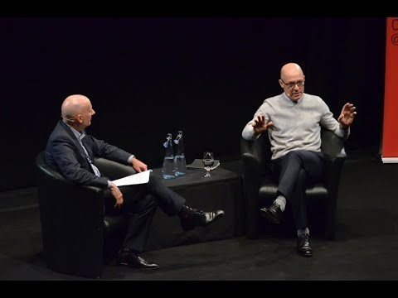
What 3 key lessons does he talk about ? How can we apply these in a school setting?
Notes:
Get inside the shoes of your team – create an optimal environment
Break down small steps to your goal – small improvements, Idea of continuous learning and improvement, Link between dreams and targets
Forget the results to limit the impact of emotions
What is in it for each individual? Give everyone ownership to influence the what and how

Slide 5
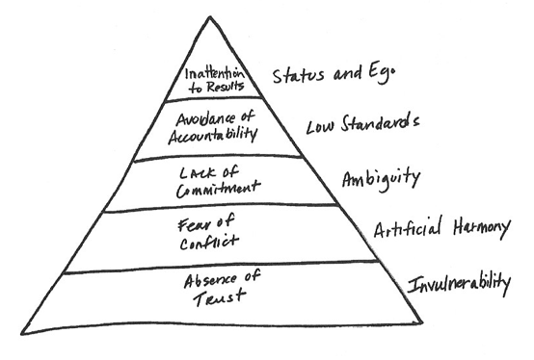
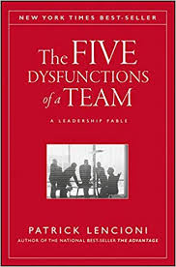
So, what will stop you being a successful team?
Notes:
Patrick Lencioni (wrote the bestselling business book with this title) identified that there are five dysfunctions that holds team back.
The first is the absence of trust, which means members of the team fear being vulnerable with team members present. This is really normal when people are working together for the first time, or when you are dealing with pre-existing relationships where trust has been lost.
The fear of being vulnerable with team members prevents the building of trust within the team.

Slide 6
Teams who trust each other
Teams who do not trust each other
Admit weakness and mistakes
Ask for help
Accept questions about their area
Give one another the benefit of the doubt
Take risks in offering feedback and assistance
Appreciate and tap into one another’s skills and experiences
Focus time and energy on important issues, not politics
Offer and accept apologies without hesitation
Look forward to meetings and other opportunities to work as a group
Conceal their weaknesses and mistakes
Hesitate to offer or ask for help or give feedback
Jump to conclusions about the intentions and aptitudes of others
Fail to recognise and tap into one another’s skills
Hold grudges
Dread meetings

Slide 7
Think back to a conflict which didn’t get resolved. How did that make you feel?
Notes:
The fear of conflict leads us to a desire to preserve artificial harmony, which in turn stifles the occurrence of productive, ideological conflict. I imagine you all will be able to think of an example where you took avoided conflict to preserve harmony. But what is the effect?

Slide 8
Teams who do not avoid conflict
Teams who avoid conflict
Have lively interesting meetings
Extract and explore the ideas of all team members
Solve real problems quickly
Minimise politics
Put critical topics on the table for discussion
Have boring meetings
Create environments where back-channel politics and personal attacks thrive
Ignore controversial topics that are critical to team success
Fail to tap into all the opinions and perspectives of team members
Waste time and energy with posturing and interpersonal risk management

Slide 9
Notes:
The third dysfunction in the lack of commitment from team members and this leads to ambiguity, with the lack of clarity or buy-in preventing team members from
making decisions they will stick to.
Without sorting out the trust and the fear of conflict, it will be hard to reach a point where you get genuine commitment.

Slide 10
Notes:
The fourth is an avoidance of accountability. The need to avoid interpersonal discomfort prevents team members from holding one another accountable for their
behaviours and performance. This in term leads to low standards.
See the training on ‘difficult conversations’ to help with this one from a leaders perspective. But truly great teams will have also created an environment where members feel that its okay to call each other out if they are not demonstrating the behaviours that makes them the great team. Often our pupils are much better at this then we are with our colleagues.
Task: Discuss in your groups, how you would approach a situation where one of the members in your team was not displaying an agreed behaviour or action. Give a scenario such as ‘You are a head of department. As a middle leadership team you have agreed on the new school marking policy. You all agreed in the meeting you were happy with it and would trial it for three months and evaluate. You walk into the staffroom to hear one of your co-colleagues laughing with some teachers saying they are going to ignore the marking policy, it is a waste of time’.

Slide 11
3-minute read https://www.entrepreneur.com/article/238283
Notes:
The final dysfunction is the inattention to results. It happens where the pursuit of individual goals and personal status erodes the focus on collective success.
For a team to work well, everybody has to make collective results their number one priority. The problem is that, more often than not, people will focus on their individual goals rather than on team achievements, adopting a “my part of the boat is not sinking” approach. Even with the best intentions, there is a natural tendency for colleagues to put their department ahead of the whole school or trust, because they feel closer to that group and responsible for its members.
However, it’s important to understand that individual team members are expected to always do what’s best for the organisation, not to fight for their functional area of expertise. On an effective team, colleagues are willing to sacrifice the results or the well-being of their subgroup for the good of the whole.

Slide 13
What do they have in common?
Notes:
Task: 2 minutes in pairs to discuss what do all these have in common?
The answer is that they are all highly effective teams.
British Olympic cycling team. - Won 8 gold medals at Beijing Olympics led by performance director Dave Brailsford.
Arsenal women's team - In 22 years, up until the 2008/9 season Arsenal Women’s Team won
33 major trophies including 1 Women’s UEFA Cup, 3 domestic Trebles, 12 Premier League Titles, 10 National League Cups and 10 FA Cups, further cementing the Ladies team really are the present dominant force in the English domestic game. They won their 7th successive Premier League title this year…
Girls aloud : Sold 10 million records worldwide
Most consecutive top ten entries by a female group
All album have gone platinum.
Must successful reality tv group
The New York city ballet: The New York City Ballet, one of the foremost dance companies in the world, is unique in US artistic history. Solely responsible for training its own artists and creating its own works, the New York City Ballet was the first ballet institution in the world with two permanent homes, the David H. Koch Theater at Lincoln Center and the Saratoga Performing Arts Center in Saratoga Springs, New York

Slide 14
Effective Middle Leadership Session 1b – Building a Team
Area of focus:
Building Teams
Key questions/lines of enquiry:
How can we develop an effective team and what barriers might we face?
Desired outcomes:
-identify common features of a great team
-gain practical wats in which to build a team

Slide 15
Collective Success
Keeping your team focused on whole school goals.
Making sure results are achievable.
Prioritise team needs over personal individual ones.
Taking collective responsibility for mistakes.
Celebrating successes.
Notes:
Keep your team focused on whole school goals. Use your action plan and display objective information on how well the team performing towards this, and how much time they have left to reach objectives. Make it really clear in all of your dialogue that you see this as a collective responsibility, if someone is slipping on their area, pull the team around them. This is really useful for things like heads of year where one form is slipping on attendance – what would be one action we could all do to help this form as a team?
Make sure the results are achievable. It’s important to make sure that the team is convinced that they will make it. If objectives are too ambitious, team members risk giving up. They will stop trying and focus their energy on personal goals, which is precisely what should be avoided.
Prioritise team needs over personal individual ones. This can require a change of mindset; it means that when necessary, colleagues are able to make sacrifices for the good of the team. They must be willing to drop individual projects to help a teammate, or to switch priorities to re-align with the organization’s overall strategy. It’s a state of mind that requires a lot of flexibility, adaptability and nimbleness.
Taking collective responsibility for mistakes. Dealing with failure is one of the biggest challenge for a team, and the natural tendency is to blame other colleagues or external factors when things go wrong. The goal for healthy teams is to face the mistake, acknowledge it and start working together to prevent it from happening again in the future.
Celebrating successes. Just like mistakes should be acknowledged, successes must be praised! It’s great to recognize the individual contributions of colleagues; it will be a great reminder that the whole team is on the way to achieving the collective goals it set out to reach.

Slide 16
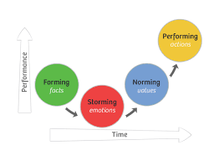
Tuckmann’s Model of Change/Group Development
Notes:
A very old model, but one that is still as true today as it was in 1965 when it was published. This is Tuckman's Group Development Model.
Tuckmann did a piece of research looking at the behaviour of small groups in a variety of environments, he recognised the distinct phases they go through, and suggested they need to experience all four stages before they achieve maximum effectiveness.
We think it is worthwhile looking at the stages, because it is good to start recognising where you own team might be in their development, even if it doesn’t fit neatly in this model.

Slide 17
Forming
The team
meets and learns about the opportunity and challenges
agrees on objectives and begins to plan activity
Team members
tend to behave quite independently
are usually on best behaviour but focussed on their own performance
get to know each other
develop perceptions of others’ strengths and weaknesses
Notes:
In the forming phase, individual behaviour is driven by a desire to be accepted by the others, and avoid controversy or conflict. Serious issues and feelings are avoided, and people focus on being busy with routines, such as team organisation, who does what, when to meet, etc. But individuals are also gathering information and impressions - about each other, and about the scope of the task and how to approach it. This is a comfortable stage to be in, but the avoidance of conflict and threat means that not much actually gets done.

Slide 18
Storming
The team starts to address issues such as what problems they are really supposed to solve
Different ideas start to compete for consideration
Team members
debate how they will function independently and collectively and what leadership model they will accept
start to open up to each other and confront each other's ideas and perspectives
This stage can be contentious, unpleasant and even painful...but it is growth!
Notes:
Individuals in the group can only remain nice to each other for so long, as important issues start to be addressed. Some people's patience will break early, and minor confrontations will arise that are quickly dealt with or glossed over. These may relate to the work of the group itself, or to roles and responsibilities within the group. Some will observe that it's good to be getting into the real issues, whilst others will wish to remain in the comfort and security of stage 1. Storming is an important part of leading to high performance.
For new leaders of a team, this phase can be really daunting. My advice is recognise it for what it is – a phase. Granted it can be quite a long phase and feels longer than it is when you are in it, but accepting that this is the nature of group formation will stop you being destabilised or paralysed.

Slide 19
Norming
The team agrees rules, values, professional behaviour, shared methods, working tools and even taboos
Team members
adjust their behaviour to each other as they develop work habits that make teamwork seem more natural and fluid
develop trust
Motivation increases
Notes:
As the "rules of engagement" for the group become established, and the scope of the group's tasks or responsibilities are clear and agreed. Having had their arguments, they now understand each other better, and can appreciate each other's skills and experience. Individuals listen to each other, appreciate and support each other, and are prepared to change pre-conceived views: they feel they're part of a cohesive, effective group. However, individuals have had to work hard to attain this stage, and may resist any pressure to change - especially from the outside - for fear that the group will break up, or revert to a storm.
Norming and re-norming
It has been suggested that an additional stage be added of Norming after Forming and renaming the traditional Norming stage Re-Norming. This addition is designed to reflect that there is a period after Forming where the performance of a team gradually improves and the interference of a leader content with that level of performance will prevent a team progressing through the Storming stage to true performance. This puts the emphasis back on the team and leader as the Storming stage must be actively engaged in to succeed – too many 'diplomats' or 'peacemakers' especially in a leadership role may prevent the team from reaching their full potential.
Rickards and Moger propose a similar extension to the Tuckman model when a group breaks out of its norms through a process of creative problem-solving.

Slide 20
Performing
The team functions as a unit
Team members
work smoothly and effectively without conflict
have no need for external supervision or intervention
demonstrate both dependency and independency
distribute leadership amongst themselves
are results focused and mission driven
Notes:
Not all groups reach this stage, characterised by a state of interdependence and flexibility. Everyone knows each other well enough to be able to work together, and trusts each other enough to allow independent activity. Roles and responsibilities change according to need in an almost seamless way. Group identity, loyalty and morale are all high, and everyone is equally task-orientated and people-orientated. This high degree of comfort means that all the energy of the group can be directed towards the task(s) in hand.
Adjourning and transforming
In 1977, Tuckman, jointly with Mary Ann Jensen, added a fifth stage to the 4 stages: adjourning, that involves completing the task and breaking up the team. Others call it the phase for mourning.
Task: Self reflection - where is your current team?

Slide 21
Pulling it all together. A scenario…
Bart has just joined your school as head of maths. Most of the department are brand new that year. Two had gone for the head of maths job Bart got but taken posts as maths teachers on TLRs. There are 2 NQTs. The only maths teachers remaining from the previous department are the schools union rep and a part time teacher who Bart has been told was on capability but came off because the paperwork wasn’t done well.
Bart holds his first department meeting. He is nervous. He raised implementing a new scheme of work based on maths mastery. The noticed the two that didn’t get his job smirking at each other. The NQTS looked keen but didn’t say anything. The School Union rep wasn’t there because the meeting wasn’t in directed time (Bart only found out after that staff leave at 3pm on Wednesdays) and the part time teacher spent all her time looking at her watch.
Task: Individually read through the scenario of this team.
First; establish where you think this team is on its journey of group development in Tuckmann’s model.
Secondly; which dysfunctions can you see?
Thirdly; what advice can you now give this team leader to build a better team?

Slide 22
Gap task – for our next forum on 10th Sept
5 minute video about healthy conflict and the role of emotions in building a team https://www.youtube.com/watch?v=pTtLIyXs8UU

Slide 23
Resources to print

Slide 24
The five dysfunctions of a team

Slide 25
Tuckmann’s Model of Change
Forming:
Performing:
Storming:
Norming:

