Slide 1
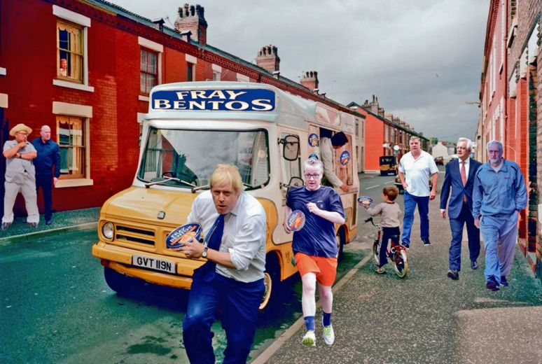
Enrichment and Cultural Capital

Slide 2
The Plan- To explore the notion of Enrichment in Ofsted Framework 2019
* What do OFSTED expect from us?
* What is Cultural Capital?
* What do we do already?
* What can we do better?
When?
TED day – launch of forum group (30 mins)
10th Sept – Thurs meeting slot
22nd Oct - – Thurs meeting slot
4th Nov – Thurs meeting slot

Slide 3
1. What does Ofsted expect from us?

Slide 4
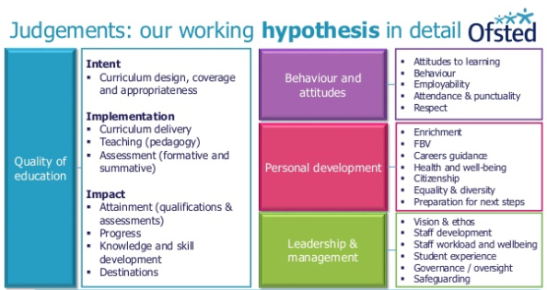

Slide 5
Quality of education 26.
Inspectors will make a judgement on the quality of education by evaluating the extent to which:
Intent
* leaders take on or construct a curriculum that is ambitious and designed to give all learners, particularly the most disadvantaged and those with special educational needs and/or disabilities (SEND) or high needs, the knowledge and cultural capital they need to succeed in life
the provider’s curriculum is coherently planned and sequenced towards cumulatively sufficient knowledge and skills for future learning and employment.
the provider has the same academic, technical or vocational ambitions for almost all learners. Where this is not practical – for example, for some learners with high levels of SEND – its curriculum is designed to be ambitious and to meet their needs
learners study the full curriculum. Providers ensure this by teaching a full range of subjects for as long as possible, ‘specialising’ only when necessary

Slide 6


Under the new framework, schools should have high and equal expectations, providing an ambitious curriculum which is studied by all.
There appears to be an emphasis on the curriculum being knowledge-rich; however, the handbook insists strongly that ‘this must not be reduced to, or confused with, simply memorising facts. Inspectors will be alert to unnecessary or excessive attempts to simply prompt pupils to learn glossaries or long lists of disconnected facts’.
The other main aspect of the curriculum is that it must deliver cultural capital defined in the handbook as ‘the essential knowledge that pupils need to be educated citizens, introducing them to the best that has been thought and said and helping to engender an appreciation of human creativity and achievement.’
This is what we are going to start looking at
However, there is also mention of the inclusion of skills teaching within the curriculum, particularly regarding preparation for both future learning and employment.

Slide 7

Personal development 28.
Inspectors will make a judgement on the personal development of learners by evaluating the extent to which:
the curriculum extends beyond the academic, technical or vocational. It provides for learners’ broader development, enabling them to develop and discover their interests and talents
the curriculum and the provider’s wider work support learners to develop their character – including their resilience, confidence and independence – and help them know how to keep physically and mentally healthy
at each stage of education, the provider prepares learners for future success in their next steps
the provider prepares learners for life in modern Britain by:
− equipping them to be responsible, respectful, active citizens who contribute positively to society
− developing their understanding of fundamental British values
− developing their understanding and appreciation of diversity
− celebrating what we have in common and promoting respect for the different protected characteristics as defined in law.
OFSTED are looking at both the Curriculum and beyond as to how we meet these expectations
- Enrichment and Cultural Capital inside and outside of lessons
Even if they are still continuing with EBACC

Slide 8
As part of making the judgement about the quality of education, inspectors will consider the extent to which schools are equipping pupils with the knowledge and cultural capital they need to succeed in life. Our understanding of ‘knowledge and cultural capital’ is derived from the following wording in the national curriculum:
‘It is the essential knowledge that pupils need to be educated citizens, introducing them to the best that has been thought and said and helping to engender an appreciation of human creativity and achievement.’
Unpick this statement- what are your initial thoughts as to what is meant?

Slide 9
