Slide 1

SEND Forum 2020 - 2021

Slide 2
Aims
Build up your SEN toolkit
Dyslexia
Differentiation
Working with TAs

Slide 3
Quiz
1. When did the current Code of Practice come into force?
September 2014
2. What are the four categories of SEN?
Communication and Interaction
Cognition and Learning
Social, mental and emotional health
Sensory and/or physical
3. What is the name of the category that replaced School Action and School Action Plus?
SEN Support
4. What does EHCP stand for?
Education, Health and Care Plan
5. Schools should adopt a 'Child ______ approach' to the SEN planning, reviewing and monitoring process.
Centred
6. How many times a year should parents be informed of the progress of their child (if they are on the SEND register)?
3
7. The current code covers children and young people from ages 0 – ___ years
25

Slide 4
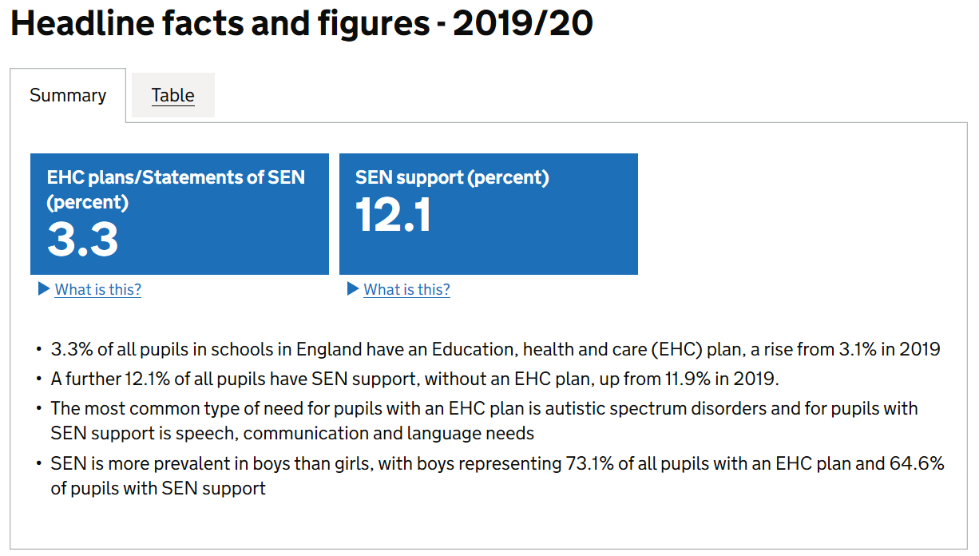

Slide 5


Follow Up

